Slide 1

Python and Machine Learning Project
Group no. 8
Sanya Gupta(502204196)
Nikita Marwaha(502204095)

Slide 2
Contents
Introduction 1
Related Works 2
Proposed Methodology 3-4
About Dataset 5
Experimental Result 6

Slide 3

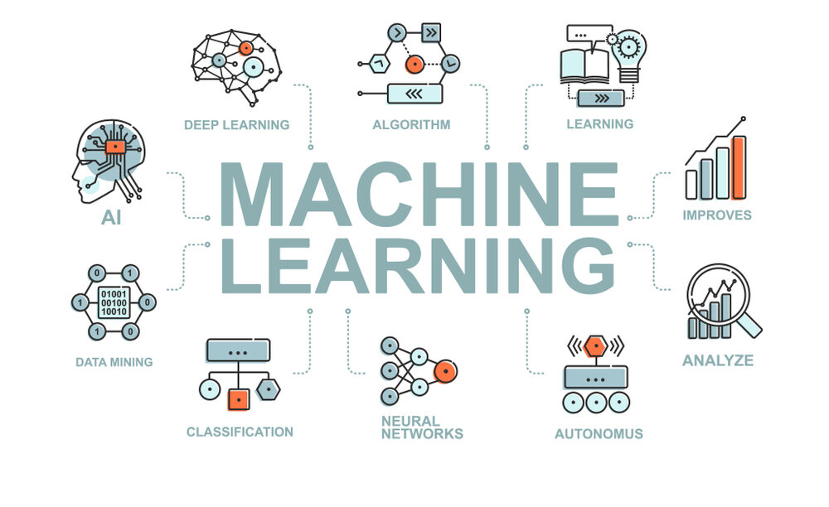
Introduction
In this projects we have taken a “Financial Sector & Services” and from this sector we have chosen “Mutual Fund” to specify its role in financial sector and economic growth.
By analyzing mutual fund performance and forecasting its future performance based on past data, shows that how MFs can contribute to economic growth and development.
These financial institutions plays a major role in any economy because these are the once who provide fund to corporates for there effective operation and for longer sustainability of the companies.

Slide 4
Related Work
Bin li & Alberto G Rossi- Used machine learning to evaluate Mutual fund in real time by combining individual and large number to compute fund level.
Alan Zhang- Applied NLP model of machine learning to predict future fund performance.
Ron Kaniel, Zihan Lin, Markus Pelger & Stijn Van Nieuwerburgh- Used Cross out sampling and conditional modelling to compare the prediction and trading benefit using ML.
Victor DeMiguel, Javier Gil-Bazo, Francisco J. Nogales, Andr´e A. P. Santos- Used Machine Learning to identify and exploit non-linearities and interactions in the relation between fund characteristics and performance.

Slide 5
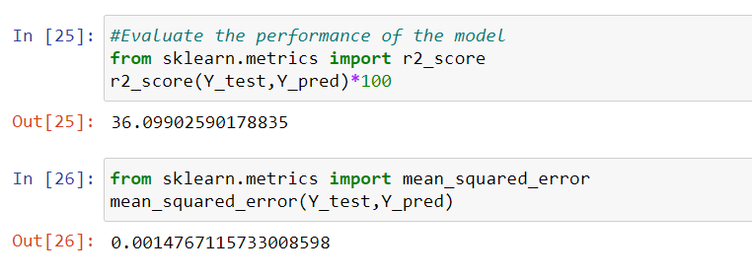
PROPOSED METHODOLOGY
To analyse the performance of the unit of the funds on the basis of the forecasting done by applying two models:
Linear Regression Model
Decision Tree Model
Linear Regression Model
It is a predictive model used for finding the relationship between Dependent and Independent variables. This predictive analysis model comes under Supervised Learning. It makes prediction for continuous/real or numeric variable. It shows the relationship between predictor and dependent variable.
In our data there are numerous independent/predictor variables and one dependent variable.
As Mutual Fund is like Stock Market Analysis whose prediction will not always be 100% accurate, our model also shows very less accuracy.

Slide 6
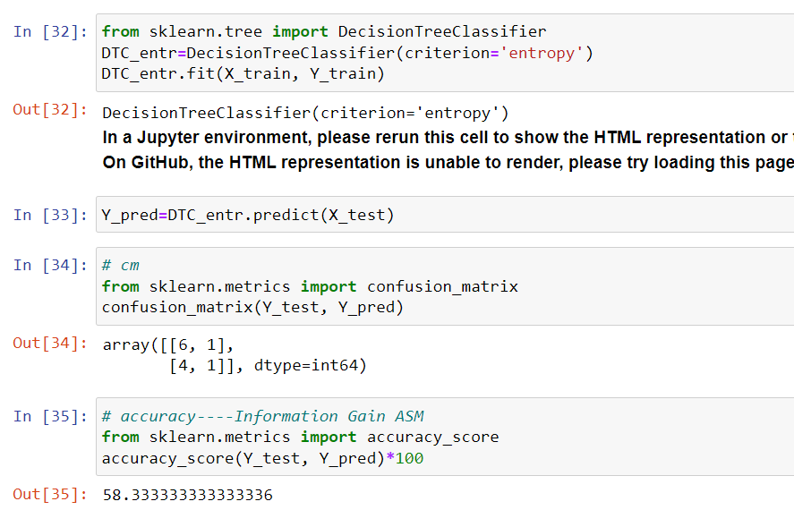
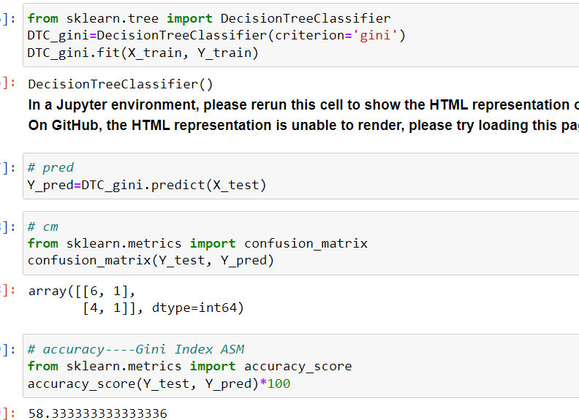
Decision Tree Model
Decision Tree model is one of the most important classification algorithm which comes under supervised learning. As it is applicable in both Regression and Classification Model but it is most applicable in classification. It consist of internal nodes, branches and leaf nodes.
In our dataset there is 2 types of plans: Regular Plan & Direct Plan.
In selecting the best attribute of both plans so as to predict which plan performs well, we have used two Attribute
Selection Measure: Information Gain & Gini Index
Information Gain- It shows how much information should be gain from the dataset. In it there is entropy which shows degree of uncertainty.
Gini Index- It shows that how randomly chosen element would be incorrectly identified. It’s values vary between 0 and1 which means if is 0 it belongs to one class and 1 means belongs to various class. Lower index is preferred as good.

Slide 7
About Dataset
Our dataset is on about Mutual Fund as we have chosen Financial Industry.
The purpose for opting mutual fund is that we want to study in dept the performance of the funds in the financial market and how these will benefit the concerned investors future decision making.
Data consists of Funds Schemes, Plans, Category of fund, Crisil Rank these all are on the basis of Year to Date(2012-2022) information.
We have applied models in this data to predict the performance of various funds for future evaluation. This shows if investors want to invest in a certain scheme of mutual funds then he/she should we well aware about the market scenario and the performance of the funds in existing scenario. If one is not aware the that person may suffer loss, but it is not always true because market is dynamic and forecasting will not always be true.

Slide 8
Experimental Result
In order to analyse the performance of the model various performance measures have been used.
In Linear Regression Model:
r2_score: 36.099%
mean_squared_error: 0.001476
In Decision Tree Model: Confusion Matrix & Accuracy Score
Information Gain: 58.33%
Gini Index: 58.33%

Slide 9
Thank You

